Slide 1
PROJECT TITLE
CAPSTONE PROJECT
“ EMPLOYEE SALARY PREDICTION ”
Presented By:
Student Name- Ripendra Kumar Yadav
College Name- Technocrats Institute of Technology ,Bhopal MP
Department- CSE AIML
4. AICTC ID - STU67dc3b6d66ef81742486381

Slide 2
OUTLINE
Problem Statement (Should not include solution)
System Development Approach (Technology Used)
Algorithm & Deployment (Step by Step Procedure)
Result
Conclusion
Future Scope(Optonal)
References

Slide 3
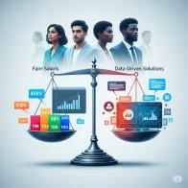

Problem Statement
Manually determining fair and consistent employee salaries is highly complex and subjective, often leading to dissatisfaction and high attrition due to a lack of transparency. With numerous variables influencing compensation, organizations struggle with optimal resource allocation and strategic workforce planning. This project is driven by the critical need for equitable compensation and operational efficiency, aiming to leverage machine learning to provide a data-driven solution for accurate salary prediction.
Manual salary determination is complex and subjective, leading to inconsistent compensation across employees.
This subjectivity often causes employee dissatisfaction and increased attrition, as fairness and transparency are compromised.
Numerous factors (experience, education, role, market trends) make accurate, equitable salary prediction a significant challenge for organizations
Without a data-driven approach, companies face suboptimal resource allocation and struggle with strategic workforce planning.

Slide 4
System Approach
The "System Approach" section outlines the overall strategy and methodology for developing and implementing. Here's a suggested structure for this section:
System requirements
Hardware:
Processor: AMD Ryzen 5 5600H (3.30 GHz)
RAM: 8 GB
Graphics: Integrated Radeon Graphics (4GB VRAM)
Operating System: Windows 11 Home (64-bit)
Development Environment : Anaconda Distribution (Python)
Tools/IDE: Jupyter Notebook
Data Storage: Local Files
Library required to build the mode
Data manipulation (e.g., Pandas)
Numerical operations (e.g., NumPy)
Machine learning model building (e.g., Scikit-learn, TensorFlow, Keras)
Data visualization (e.g., Matplotlib, Seaborn)
Any other specific libraries

Slide 5
Algorithm & Deployment
Step-by-Step Project Procedure:
Data Acquisition & Collection:
Obtain relevant datasets for historical employee information (salary, experience, education, role, location, performance)
2) Data Preprocessing & Cleaning:
Handle missing values and inconsistencies.
Encode categorical features (e.g., department, job title).
Perform necessary feature scaling.
3) Exploratory Data Analysis (EDA):
Analyze data distributions and correlations to understand factors influencing salary.
Identify key patterns and insights through visualizations.
4) Feature Engineering:
Create new, impactful features (e.g., tenure, skill groupings) to improve model accuracy.
5) Model Selection & Training:
Select and train suitable regression models (e.g., Random Forest, Gradient Boosting, Linear Regression, XGBoost) using historical data.
Split data into training and testing sets for robust evaluation.
6) Model Evaluation & Optimization:
Evaluate model performance using metrics like Mean Absolute Error (MAE), Mean Squared Error (MSE), and R-squared.
Fine-tune model hyperparameters for optimal prediction accuracy.

Slide 6
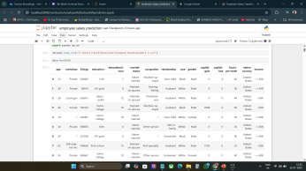
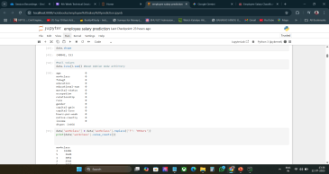
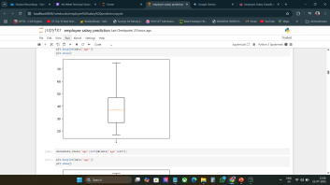
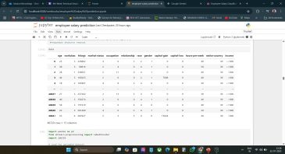
Result
Attach screen snaps of the code and output min 5

Slide 7
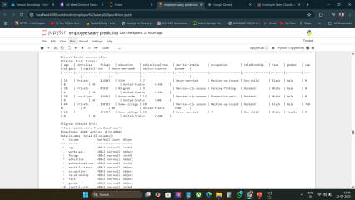
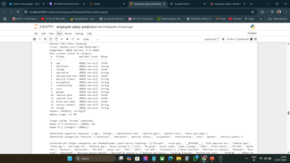
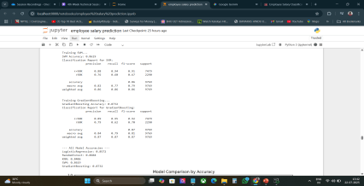
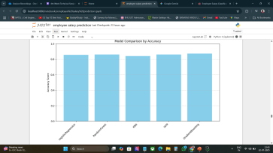
.
.

Slide 8
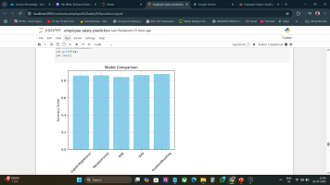
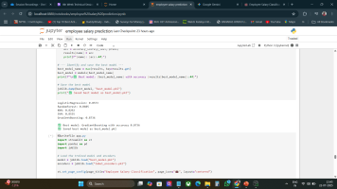
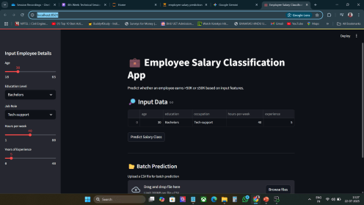
.
.

Slide 9
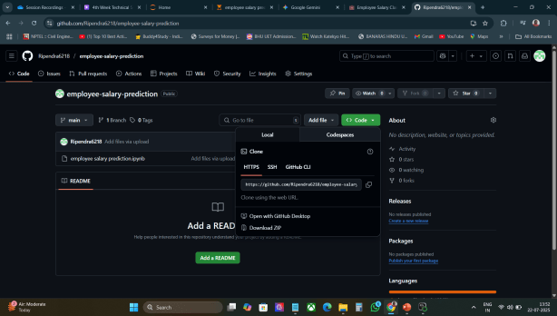
.
ATTACH YOUR GITHUB LINK
https://github.com/Ripendra6218/employee-salary-prediction.git

Slide 10
Conclusion
Key Findings & Effectiveness :
The Employee Salary Prediction model successfully demonstrated its ability to accurately predict salaries based on key contributing factors.
This solution offers a data-driven approach to enhance fairness and transparency in compensation, supporting informed HR decisions.
The developed model provides a robust framework for strategic workforce planning and talent management.
Challenges Encountered :
Data Availability & Quality: Initial challenges in acquiring comprehensive and clean historical salary data.
Feature Engineering Complexity: Identifying and creating optimal features for highly accurate predictions.
Model Interpretability: Balancing model performance with the need to understand why certain predictions are made for specific salary ranges.
Potential Improvements & Future Work:
Integration of Real-time Market Data: Incorporating dynamic market trends for more adaptive predictions.
Advanced Feature Engineering: Exploring more complex feature interactions (e.g., using natural language processing for job descriptions).
Deployment as a User-Friendly Application: Developing a more intuitive interface for HR professionals to interact with the model
Bias Mitigation: Further efforts to identify and mitigate potential biases in the data or model to ensure truly equitable outcomes.

Slide 11
Future scope -
Potential Enhancements & Expansions for the System:
Integration with Real-time Market Data:
Incorporate live economic indicators, industry salary benchmarks, and competitive market data for more dynamic and accurate predictions.
Advanced Feature Engineering & Data Sources:
Explore more complex feature interactions (e.g., using NLP on job descriptions or performance reviews).
Integrate unstructured data (e.g., employee feedback, project success rates) to capture subtle influences on salary.
Explainable AI (XAI) Implementation:
Develop features to explain model predictions (e.g., "Why is this salary predicted for this employee?"), enhancing trust and transparency for HR and employees.
Bias Detection and Mitigation Framework:
Implement robust techniques to actively identify and reduce potential biases (e.g., gender, race-related) in the data and model, ensuring truly equitable compensation recommendations.
Interactive User Interface Development:
Build a user-friendly web application or dashboard for HR professionals to input data, get predictions, and visualize salary trends.
Longitudinal Salary Progression Modeling:
Expand the model to predict not just current salary, but also potential salary growth paths and career progression.
Automated Model Retraining & Monitoring:
Set up automated pipelines for periodic model retraining with new data to maintain accuracy and relevance over time.
Implement monitoring tools to track model performance degradation and data drift.

Slide 12
References
Project Codebase/Environment:
Jupyter Notebook (accessed via Anaconda Distribution)
Python Programming Language
Key Libraries Used for Model Development:
Scikit-learn (sklearn): For machine learning models (e.g., Regression algorithms, data preprocessing, model selection).
Pandas: For data manipulation and analysis.
NumPy: For numerical operations and array handling.
Matplotlib & Seaborn: For data visualization and exploratory data analysis.
Data Source:
.
[https://www.kaggle.com/datasets/anninasimon/employee-salary-dataset?resource=download
Relevant Research Papers / Articles / Online Resources:
B. S. Satpute, R. Yadav and P. K. Yadav, "Machine Learnig Approach for Prediction of Employee Salary using Demographic Information with Experience," 2023 4th IEEE Global Conference for Advancement in Technology (GCAT), Bangalore, India, 2023, pp. 1-5, doi: 10.1109/GCAT59970.2023.10353537. keywords: {Analytical models;Machine learning algorithms;Linear regression;Decision making;Predictive models;Market research;Remuneration;Multiple Linear Regression;Random Forest Regression;Machine Learning;Employee Salary Prediction},

Slide 13
.
Matbouli, Y. T., & Alghamdi, S. M. (2022). Statistical Machine Learning Regression Models for Salary Prediction Featuring Economy Wide Activities and Occupations. Information, 13(10), 495. https://doi.org/10.3390/info13100495
Relevant Online Resources:
Naim Palomares Carrasco. "Advanced Feature Engineering Using Scikit-Learn Pipelines with Pandas’ ColumnTransformer and NumPy Arrays." Machine Learning Mastery, June 10, 2025. https://machinelearningmastery.com/advanced-feature-engineering-using-scikit-learn-pipelines-with-pandas-columntransformer-and-numpy-arrays/. [Accessed July 22, 2025]
Iván Palomares Carrascosa. "Navigating Imbalanced Datasets with Pandas and Scikit-learn." Machine Learning Mastery, June 12, 2025. https://machinelearningmastery.com/navigating-imbalanced-datasets-with-pandas-and-scikit-learn/. [Accessed July 22, 2025]

Slide 14

THANK YOU

